Slide 1

Vcu Dining
Created and Developed by: Andrew Bailey, Ayyan Talib, Brendan Dredsner, Aditya vadrevu, and Faith Butler

Slide 2
Goals of our app:
An easy to use, intuitive app and lets users view VCU dining restaurants and favorite menu items
Originally our app was intended to show users the location of restaurants based on location, range, and price
We needed to focus on a specific idea that pertains to VCU students

Slide 3
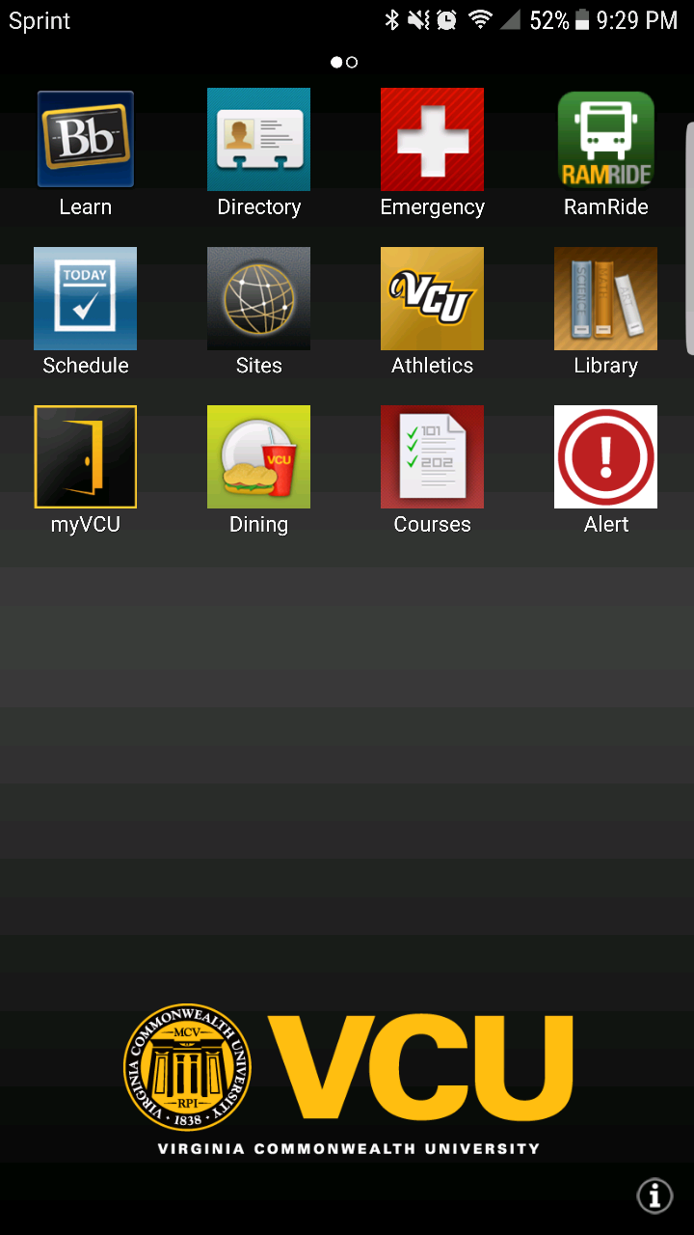
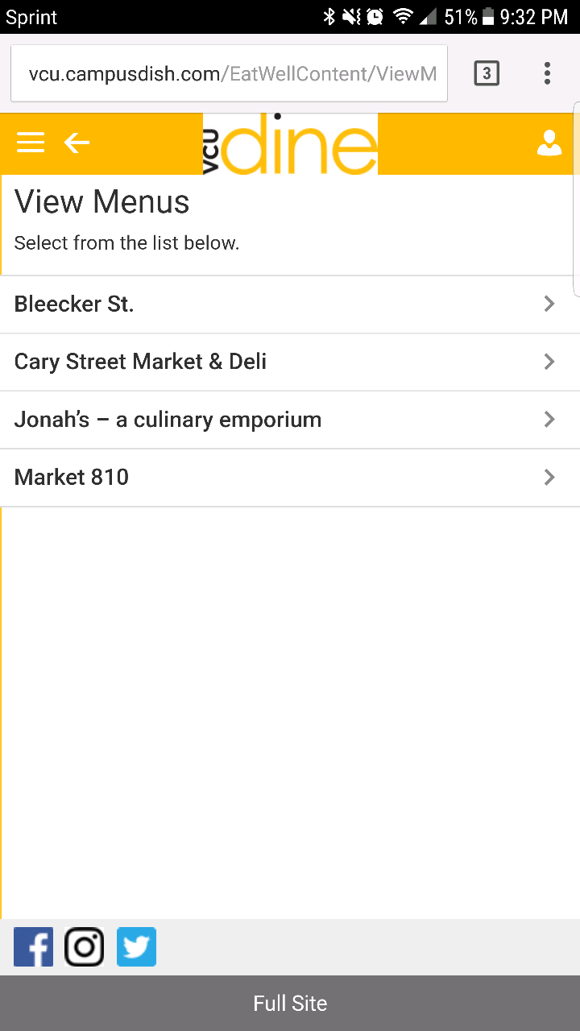
Vcu mobile
Improved upon an existing and outdated app
Not focused solely on the VCU Dining experience
Information is not contained in the app, pulls up website
Needs internet connection
4/20+ restaurants

Slide 4
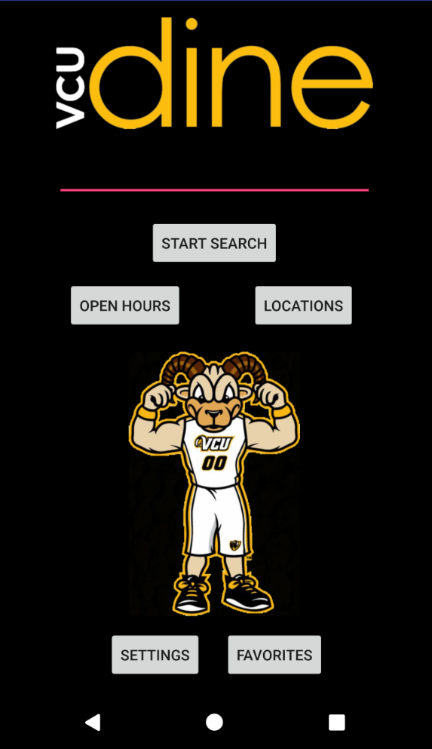
Home page
Used to find different VCU restaurants that use Dining Dollars
5 different options within the app
Search by restaurant name
Look up addresses of all locations
Find distances to restaurants
Store favorite foods
Look up operating hours

Slide 5
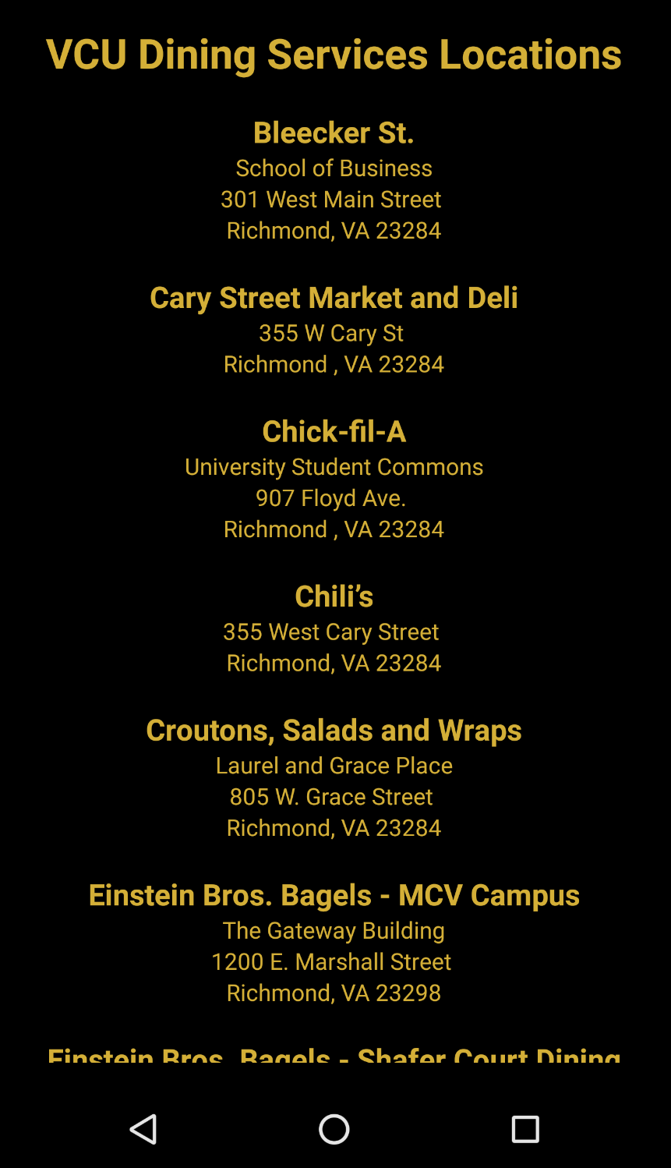
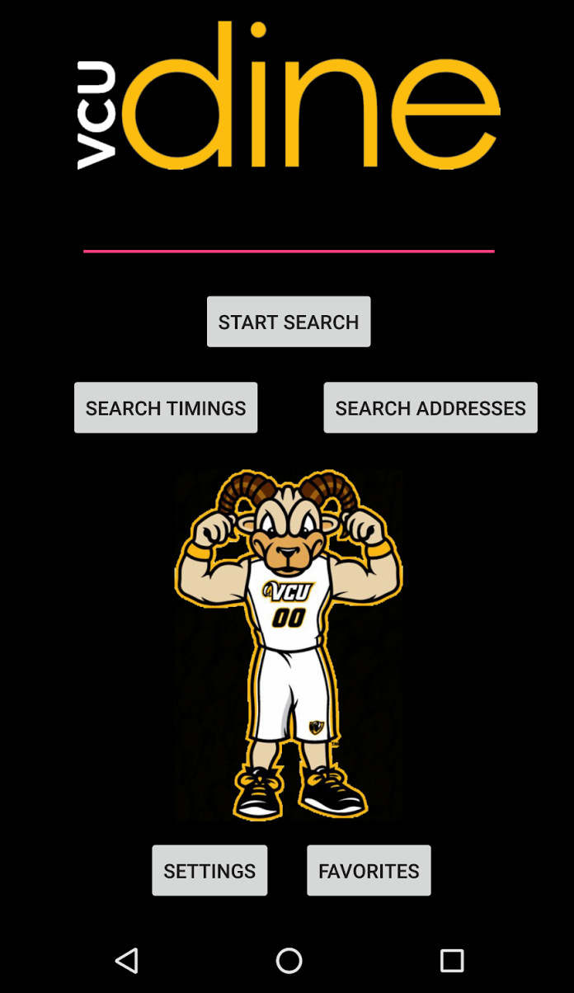
‘Locations’ page
Lists all VCU Dining restaurant addresses
Easy access for user to see location of each restaurant located within MCV and Monroe Park campus.
Over 20+ restaurants to choose from.
Enabled with a scrolling feature to allow user to easily search through all locations alphabetically

Slide 6
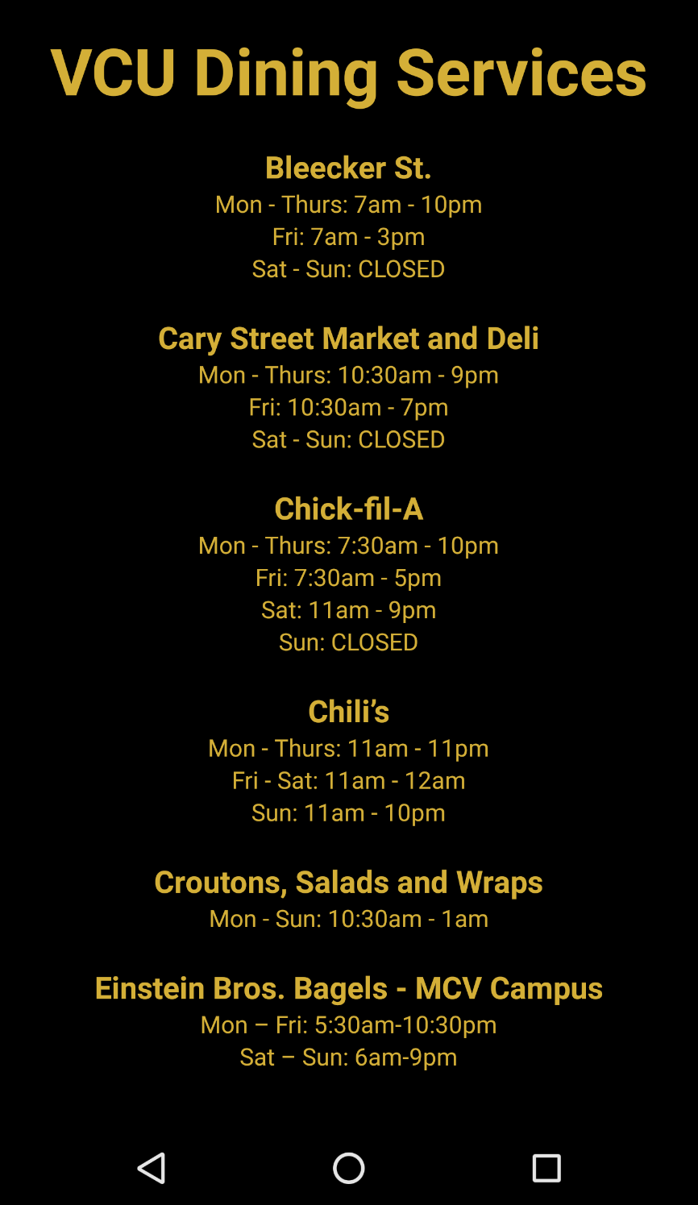
‘OPEN HOURS’ page
Lists all timings of VCU Dining restaurants
Easy access for user to see operating hours of each location throughout the week
Over 20+ restaurants to choose from
Enabled with a scrolling feature to allow user to easily search through all locations alphabetically

Slide 7
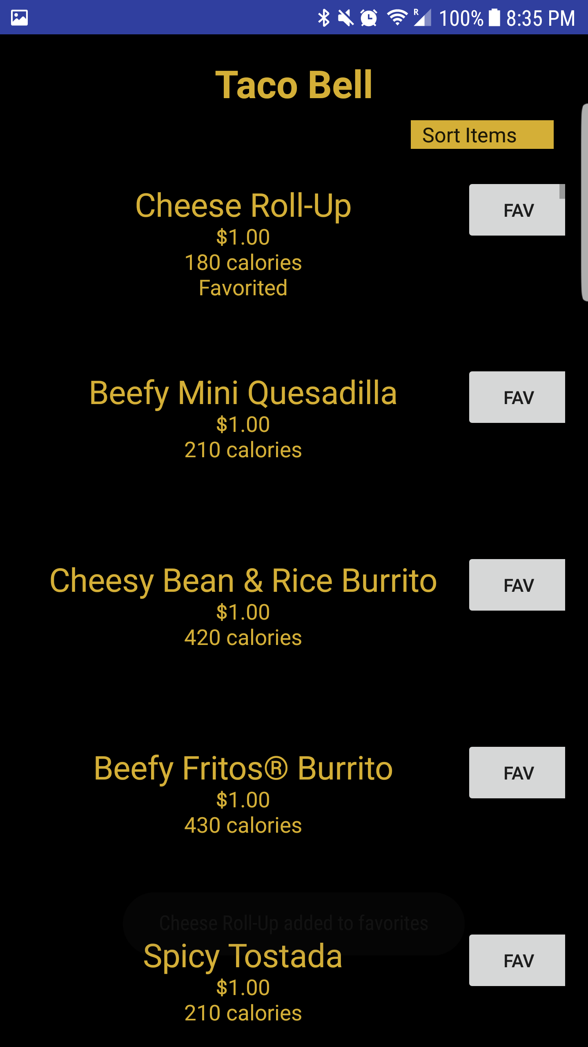
Searching by Restaurant
Enabled with scrolling feature to easily search through all menu items
If no restaurant is inputted, then the message “Restaurant does not exist” is displayed
User inputs restaurant’s name, click “Start Search”, all available menu items displayed
Name of menu item
Range of maximum and minimum calories
Price of item
Option to store it to favorites by clicking “FAV”

Slide 8
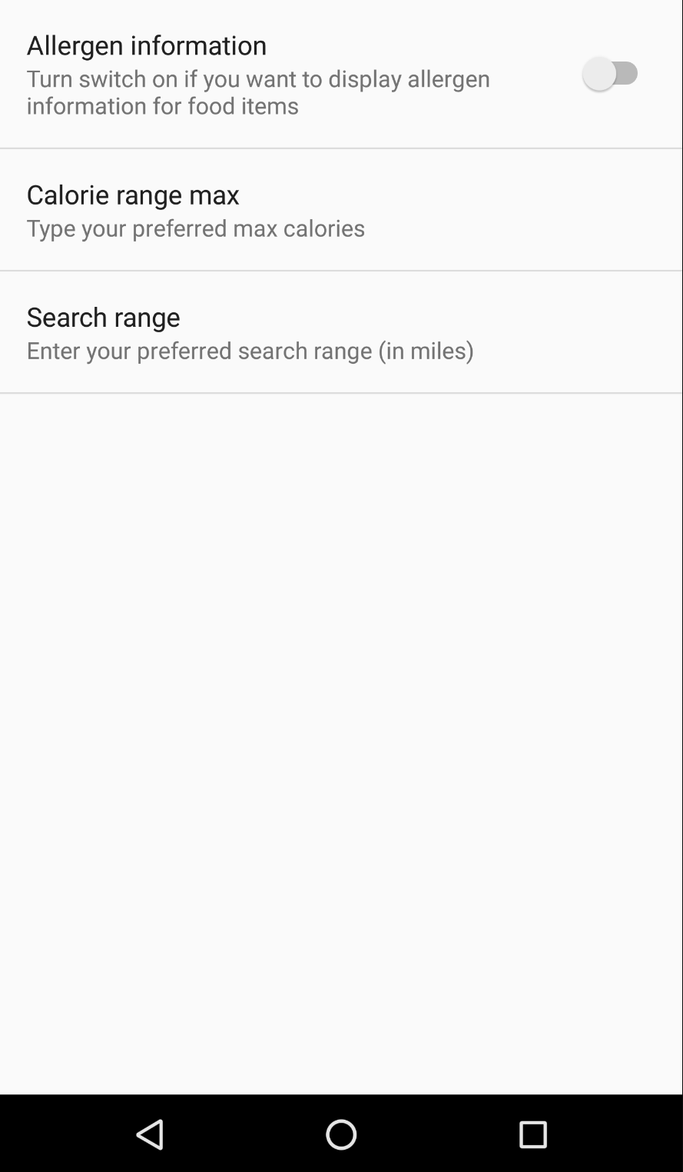
‘Settings’ page
Calorie Range Max
Put in the preferred maximum of calories
Displays menu items that are at or below the desired caloric intake
Allergen Information
Option to enable the display of allergens for each menu item
Slide bar is used to turn off or on
Search Range
User is allowed to put how far they want to travel
Locations that match this search will be displayed on the screen

Slide 9
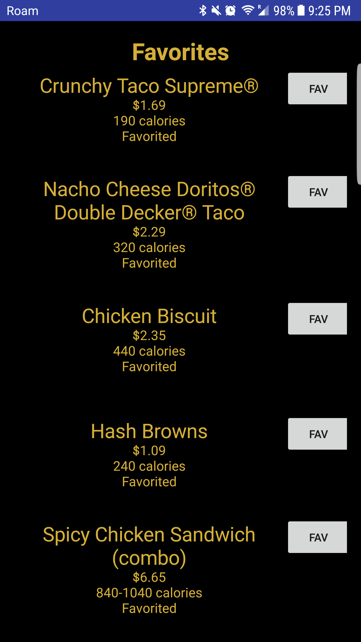
Storing to Favorites
Adding to Favorites
Message appears at bottom of screen informing user that menu item was added to his or her favorites
Menu item selected has “favorited” underneath
Menu items will be displayed in the favorite section
Removing from Favorites
To remove from favorites, click on “FAV”, message will appear at the bottom of screen stating the item has been removed
The message “favorited” is removed
To see updated version of favorites, re-open page

Slide 11
Sorting Menu items
Enabled with a drop-down menu
Option to sort by:
Menu item names (alphabetically)
Prices from low to high
Calories from low to high

Slide 12
implementation
Used SQLite database to pull information for each restaurant
Reads information from a text file on initial launch
Creates food item objects which then creates queries in the database
Distance
Used location class from android that requests permission from user to access location services
List view
We implemented a list view to update the restaurant page programmatically
Each list view item implements an adapter that extends base adapter which handles the output of the list

Slide 13
implementation
Search bar
Sends a string that user inputs into the next activity using intents
Using that string, the list view searches through the database and adds the items in to an array list
Using the array list of food items, the list view handles the output that shows on the screen
Sorting
We implemented a quicksort algorithm which takes the array list of food items and sorts based on price, calories, and alphabetically
Settings
Implemented using preference header
Allergens
max calories
maximum range

Slide 14
Difficulties
Prioritizing and abandoning user stories
Settings page was not fully implemented because in the process of development we found the information became redundant
Reading from the text file
Originally we were going to use file class but gave us many problems
“File not found”
Database implementation
No prior knowledge of SQLite in Android implementation
Creating database and helper classes was difficult
Favorites
Pulling information from database and storing based on ID
Displaying favorited foods on favorites page

Slide 15
Successes
Provided a reliable way to search the menu of a restaurant
Quick and easy access to hours, locations, and distances
Implemented UI design practices with ease
Simple for the user
Implementing quicksort with database items

Slide 16
For next time…
More meetings
Better communications
Start with a specific goal that has a niche and expand on app
Focus on core aspects of app first, then get to details
Have a clear plan on how you want the app to look/workA

Slide 17

VCU dining
Aditya Vadrevu
Ayyan Talib
Andrew Bailey
Faith Butler
Brendan Dresdner

